Slide 1
IP Addressing

Slide 2
What is an IP address?
Each host on a TCP/IP network is uniquely identified at the IP layer with an address.
An Internet Protocol (IP) address specifies the location of a host or client on the Internet.
How we remember it?
By Domain Name
www.yahoo.com
www.skylove.co.kr

Slide 3
Domain Name
Domain name is a standard Internet address i.e. User name, followed character @, followed by the name of the computer.
User name or UserID forms the first part of the address.
The part of address after @ is called the DOMAIN
Internet address=>userID@Domain
Each part of DOMAIN is called sub-domain separated by a dot.
Right most sub-domain is called Top-Level Domain.

Slide 4
Internet addressing
Two types of Top Level Domains are Used:
Organisational Top Level Domain
Geographical Top Level Domain
Organisational Geographical
.com-Commercial Organisation .np- nepal
.edu- Educational Institution .in- India
.gov- Government .ca- Canada
.int - International Organisation .np- Nepal
.net - Networking Organisation .jp- Japan
.org - Non Profit Organisation .kr- Korea
.mil - Military Organisation .uk- UK

Slide 5
IP address & DNS
The IP address is also known as Protocol address.
The conversion of Domain Name to IP address is done by Domain Name Service.
Domain Name Service allows user to establish connections to network stations using human readable names instead of cryptic network address.
DNS is a name to network address translation service.

Slide 6
IPv4 Address Scheme
The IP address is of the form <networkID,hostID>.
The address is not really separated but is read as a whole.
The address is 32 bits in length which is further separated into 4 bytes of 8 bits each.
How we remember an IP address?
www.yahoo.com
How we see an IP address? 202.14.64.1
What the Internet machines see an IP address? 11001010000011100100000000000001

Slide 7
IPv4 Addressing
32 Bits
Network Host
8 Bits
8 Bits
8 Bits
8 Bits
172 . 16 . 122 . 204

Slide 8
IPv4 Address Scheme
The address can be expressed in decimal, octal, hexadecimal or binary.
Most common IP address form is Dotted Decimal Notation i.e. Decimal equivalent of each byte is separated by a dot.
In decimal the address range is 0.0.0.0 to 255.255.255.255.

Slide 9
IPv4 Address Scheme
Two types of addressing schemes for IPv4
Classful
Classless
Classful
Original style of addressing based on first few bits of the address.
Generally used in customer sites.
Classless
A new type of addressing that disregards the class bit of an address and applies a variable prefix (mask) to determine the network number.

Slide 10
IPv4 Address Scheme
There are five classes of addresses A, B, C, D & E.
A, B & C classes are used to represent host and network address.
Class D is a special type of address used for multicasting.
Class E is reserved for experimental use.

Slide 11
IPv4 Address classes
Class-A:
N
H
H
H
Class-B:
N
N
H
H
Class-C:
N
N
N
H
Class-D:
For Multicast
Class-E:
For Research
N=Network number assigned by IR.
H=Host number assigned by network administrator.

Slide 12
Identifying a class of address
Address Identifier
Network Address
Host Address
A
0
7 bits Network Address
24 bits Host Address
B
10
14 bits Network Address
16 bits Host Address
C
110
21 bits Network Address
8 bits Host Address
D
1110
Multicast address (224.0.0.0-239.255.255.255)
E
1111
Reserved for future use

Slide 13
Class-A address (Networks)
0XXXXXXX
XXXXXXXX
XXXXXXXX
XXXXXXXX
Network
Host
0
7 bits Network Address
24 bits Host Address
Number of Networks = 2⁷ i.e.128 (0-127)
Network ID ‘0’ is not used.
Network ID ‘127’ is reserved for loop back and is used for internal testing.
Number of Networks = 126
Network IDs = 1-126

Slide 14
Class-A address (Hosts)
0XXXXXXX
XXXXXXXX
XXXXXXXX
XXXXXXXX
Network
Host
0
7 bits Network Address
24 bits Host Address
Number of Hosts=2²⁴=16777216
No Host ID can have all zeros i.e. 0.0.0 and specifies network address.
No Host ID can have all ones i.e. 255.255.255 and specifies the broadcast address.
Number of Hosts per network= 2²⁴ -2=16777214

Slide 15
IPv4 address
All 0s in the host ID indicates the NETWORK itself.
All 1s in the host ID indicates the BROADCAST address.
203.251.7.0
168.126.0.0
203.251.7.255
168.126.255.255
203.251.7.0000 0000
168.126.0000 0000.0000 0000
203.251.7.1111 1111
168.126.1111 1111.1111 1111

Slide 16
Class-B address
0XXXXXXX
XXXXXXXX
XXXXXXXX
XXXXXXXX
Network
Host
10
14 bits Network Address
16 bits Host Address
Number of Networks = 2¹⁴ i.e.16384
Number of Hosts = 2¹⁶ i.e. 65,536 (0-65,535)
No Host ID can have all zeros i.e. 0.0 and specifies network address.
No Host ID can have all ones i.e. 255.255 and specifies the broadcast address.
Number of Hosts per network= 2¹⁶ -2=65354

Slide 17
Class-C address
0XXXXXXX
XXXXXXXX
XXXXXXXX
XXXXXXXX
Network
Host
110
21 bits Network Address
8 bits Host Address
Number of Networks = 2²¹ i.e. 2097152
Number of Hosts = 2⁸ i.e. 256 (0-255)
No Host ID can have all zeros i.e. 00000000 and specifies network address.
No Host ID can have all ones i.e. 11111111 and specifies the broadcast address.
Number of Hosts = 2⁸-2 = 254

Slide 18
Class-D & E addresses
1110
Multicast address (224.0.0.0-239.255.255.255)
Class D are special addresses are known as multicast addresses.
This address is assigned to a group of networks and not to represent a unique address.
This address is used to send IP datagrams to a group but not to all the hosts on the network.
This address is also used to address router update messages.
1111
Reserved for future use

Slide 19
IP Address Bit Patterns
8 Bits
8 Bits
8 Bits
8 Bits
Class-A:
0 0 0 0 0 0 0 0
0 1 1 1 1 1 1 1
0-127
Class-B:
1 0 0 0 0 0 0 0
1 0 1 1 1 1 1 1
128-191
Class-C:
1 1 0 0 0 0 0 0
1 1 0 1 1 1 1 1
192-223
Class-D:
1 1 1 0 0 0 0 0
1 1 1 0 1 1 1 1
224-239
Class-E:
1 1 1 1 0 0 0 0
1 1 1 1 1 1 1 1
240-255

Slide 20
Class A, Class B, and Class C
Class A, Class B, and Class C are the three classes of addresses used on IP networks in common practice, with three exceptions as follows.
IP Loopback Address
Zero Addresses
Private Addresses

Slide 21
IP Loopback Address
127.0.0.1 is the loopback address in IP.
Loopback is a test mechanism of network adapters. Messages sent to 127.0.0.1 do not get delivered to the network. Instead, the adapter intercepts all loopback messages and returns them to the sending application.
IP applications often use this feature to test the behavior of their network interface.

Slide 22
IP Loopback Address
As with broadcast, IP officially reserves the entire range from 127.0.0.0 through 127.255.255.255 for loopback purposes. Nodes should not use this range on the Internet, and it should not be considered part of the normal Class A range.

Slide 23
Zero Addresses
As with the loopback range, the address range from 0.0.0.0 through 0.255.255.255 should not be considered part of the normal Class A range. 0.x.x.x addresses serve no particular function in IP, but nodes attempting to use them will be unable to communicate properly on the Internet.

Slide 24
Address space utilisation
128
127
10000000
100%
01111111
B-25%
10111111
0
191
0
1
A-50%
192
11000000
0
1
C-12.5%
11011111
1
223
0
D-6.25%
1
224
11100000
239
0
11101111
240
00000000
E-6.25%
255
0
11110000
11111111

Slide 25
Networks Vs Hosts
In Classless environment we can have 2³²=4294967296 Hosts
Class Networks Hosts/Network
A 126 16777214
B 16384 65354
C 2097152 254

Slide 26
What’s wrong with the address?
In classful addressing a range of bits is applied to an address, most of which are wasted
Having 16777214 hosts for Class-A and 254 hosts for Class-C were not working well.
Every IP address requires one entry in the routing table.
Addresses were arbitrarily handed out without regard to geographic location.
Class C addresses were overtaxing the Internet routing tables.
Class A stopped being handed out and Class-B was exhausted.

Slide 27
IP Address Restrictions
The host portion of address can not be set to all 0s or all 1s.
Any address with all 0s in the network portion of the address space is meant to be “this” network.
Addresses can not be out of the 255 range for each byte.
0.0.0.0
Used as source address in a boot (BOOTP/DHCP) configuration request.
Also denotes the default route in a routing table.

Slide 28
Network Addresses
The network address is the first address in the block.
The network address defines the network to the rest of the Internet.
Given the network address, we can find the class of the address, the block, and the range of the addresses in the block

Slide 29

In classful addressing, the network address (the first address in the block) is the one that is assigned to the organization.

Slide 30
Example 8
Given the network address 132.21.0.0, find the
class, the block, and the range of the addresses
Solution
The 1st byte is between 128 and 191.
Hence, Class B
The block has a netid of 132.21.
The addresses range from
132.21.0.0 to 132.21.255.255.

Slide 31
.
Mask
A mask is a 32-bit binary number.
The mask is ANDeD with IP address to get
The block address (Network address)
Mask And IP address = Block Address

Slide 32
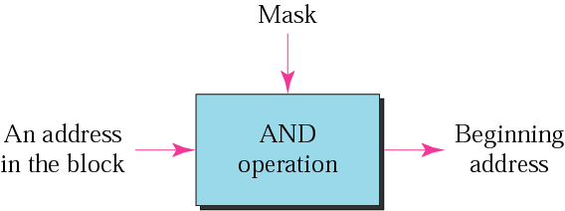
Masking concept

Slide 33
The network address is the beginning address of each block. It can be found by applying the default mask to any of the addresses in the block (including itself). It retains the netid of the block and sets the hostid to zero.

Slide 34
Default Mask
Class A default mask is 255.0.0.0
Class B default mask is 255.255.0.0
Class C Default mask 255.255.255.0

Slide 35
Subnetting
Chopping up of a network into a number of smaller networks is called subnetting.
Allows to assign some of the bits, normally used by the host portion of the address, to the network portion of the address.
The format of subnetted IP address would be <network number, subnet number, host number>
Efficiently uses the full network address.
Provides for another hierarchy of routing.
Subnet is a real network under a network.
Any of the classes can be subnetted.

Slide 36
Subnetting (Cont.)
The 2 primary benefits of subnetting are:
Fewer IP addresses, often as few as one, are needed to provide addressing to a network & subnetting.
Subnetting usually results in smaller routing tables in routers beyond the local internetwork.

Slide 37
Borrowing Bits to Grow a Subnet
The key concept in subnetting is borrowing bits from the host portion of the network to create a subnetwork.
Rules govern this borrowing, ensuring that some bits are left for a Host ID.
The rules require that two bits remain available to use for the Host ID& that all of the subnet bits cannot be all 1s or 0s at the same time.

Slide 38
Borrowing Bits to Grow a Subnet (Cont.)
For each IP address class, only a certain number of bits can be borrowed from the host portion for use in the subnet mask.

Slide 39
Borrowing Bits to Grow a Subnet (Cont.)
Bits Available for Creating Subnets
Address Class
Host Bits
Bits Available for Subnet
A
24
22
B
16
14
C
8
6

Slide 40
Subnet Mask
172
16
13
12
IP Address
Network
Host
Default / Natural Mask
255
255
0
0
Network
Host
8 bit Subnet Mask
255
255
255
0
Network
Subnet
Host
Default / Natural Mask : 172.16.13.12 /16
8 bit Subnet Mask : 172.16.13.12/24

Slide 41
Subnetting
X.X.X.0
X.X.X.00000000
X.X.X.10000000
Subnet-2 X.X.X.128
Subnet-1 X.X.X.0
0000000 - 0
0000001 - 1
0000010 - 2
. .
. .
1111110 - 126
1111111 - 127
1
0
Hosts:
2⁷-2=126
(1-126)
Hosts:
2⁷-2=126
(1-126)

Slide 42
Subnetting
X.X.X.0
X.X.X.00000000
X.X.X.01000000 X.X.X.10000000
X.X.X.11000000
SN3
X.X.X.128
SN2
X.X.X.64
Hosts:62
Hosts:62
0
1
000000 - 0
000001 - 1
000010 - 2
. .
. .
111110 - 62
111111 - 63
1
0
SN4
X.X.X.192
1
0
SN1
X.X.X.0
Hosts:62
(1-62)
Hosts:62
(1-62)

Slide 43
Reasons for Subnetting
Large networks need to be segmented into smaller sub-networks, creating smaller groups of devices and services in order to:
Control traffic by containing broadcast traffic within subnetwork
Reduce overall network traffic and improve network performance
Subnetting - process of segmenting a network into multiple smaller network spaces called subnetworks or Subnets.
Communication Between Subnets
A router is necessary for devices on different networks and subnets to communicate.
Each router interface must have an IPv4 host address that belongs to the network or subnet that the router interface is connected to.
Devices on a network and subnet use the router interface attached to their LAN as their default gateway.

Slide 44
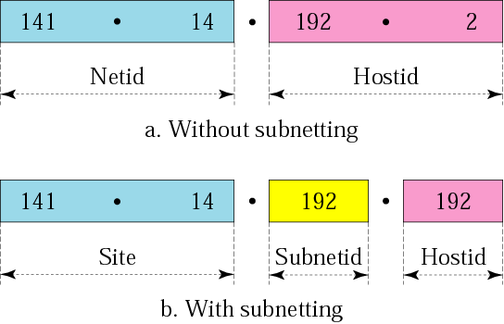
Addresses in a network with and without subnetting

Slide 45
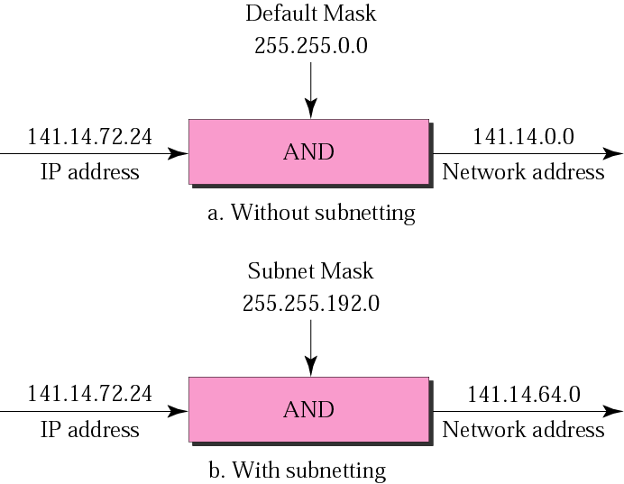
Default mask and subnet mask

Slide 46
Finding the Subnet Address
Given an IP address, we can find the subnet address the same way we found the network address. We apply the mask to the address. We can do this in two ways: straight or short-cut.

Slide 47
Straight Method
In the straight method, we use binary notation for both the address and the mask and then apply the AND operation to find the subnet address.

Slide 48
Example
What is the subnetwork address if the destination address is 200.45.34.56 and the subnet mask is 255.255.240.0?

Slide 49
Solution
11001000 00101101 00100010 00111000
11111111 11111111 11110000 00000000
11001000 00101101 00100000 00000000
The subnetwork address is 200.45.32.0.

Slide 50
Short-Cut Method
If the byte in the mask is 255, copy the byte in the address.
If the byte in the mask is 0, replace the byte in the address with 0.
If the byte in the mask is neither 255 nor 0, we write the mask and the address in binary and apply the AND operation.

Slide 51
Example
What is the subnetwork address if the destination address is 19.30.80.5 and the mask is 255.255.192.0?

Slide 52
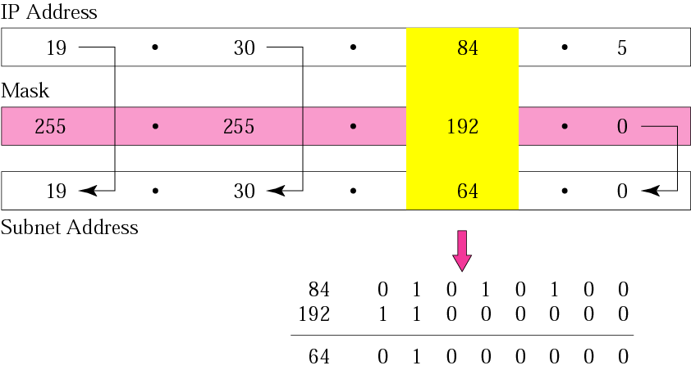
Solution

Slide 53
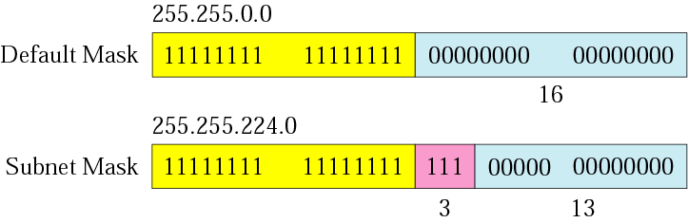
Comparison of a default mask and a subnet mask

Slide 54
The number of subnets must be a power of 2.

Slide 55
Example
A company is granted the site address 201.70.64.0 (class C). The company needs six subnets. Design the subnets.
Solution
The number of 1s in the default mask is 24 (class C).

Slide 56
Solution (Continued)
The company needs six subnets. This number 6 is not a power of 2. The next number that is a power of 2 is 8 (2³). We need 3 more 1s in the subnet mask. The total number of 1s in the subnet mask is 27 (24 + 3).
The total number of 0s is 5 (32 - 27). The mask is

Slide 57
Solution (Continued)
11111111 11111111 11111111 11100000
or
255.255.255.224
The number of subnets is 8.
The number of addresses in each subnet is 2⁵ (5 is the number of 0s) or 32.

Slide 58
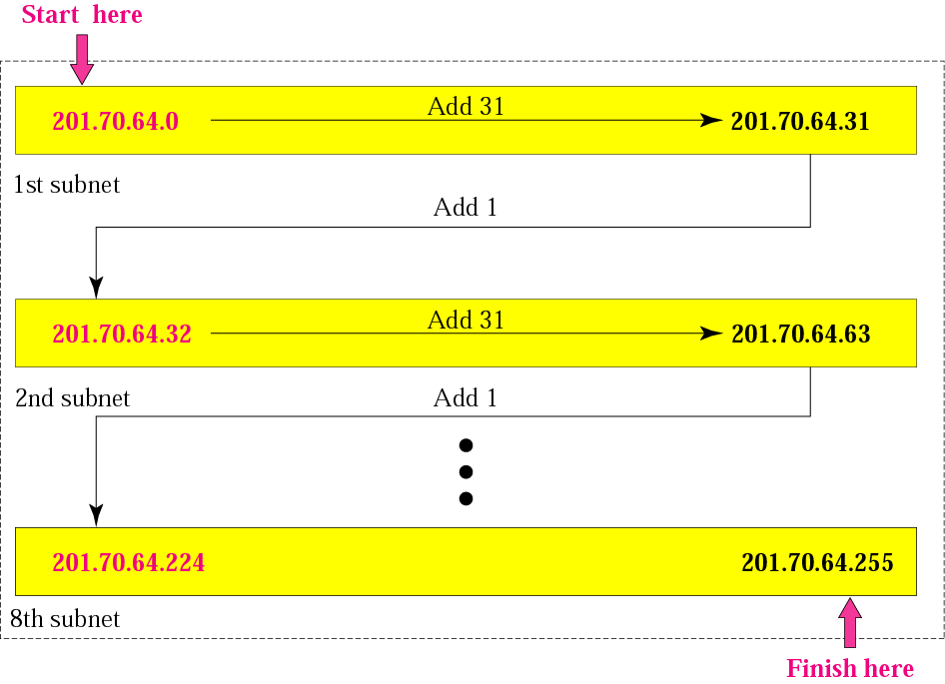
Example 3

Slide 59
Example
A company is granted the site address 181.56.0.0 (class B). The company needs 1000 subnets. Design the subnets.
Solution
The number of 1s in the default mask is 16 (class B).

Slide 60
Solution (Continued)
The company needs 1000 subnets. This number is not a power of 2. The next number that is a power of 2 is 1024 (2¹⁰). We need 10 more 1s in the subnet mask.
The total number of 1s in the subnet mask is 26 (16 + 10).
The total number of 0s is 6 (32 - 26).

Slide 61
Solution (Continued)
The mask is
11111111 11111111 11111111 11000000
or
255.255.255.192.
The number of subnets is 1024.
The number of addresses in each subnet is 2⁶ (6 is the number of 0s) or 64.

Slide 62
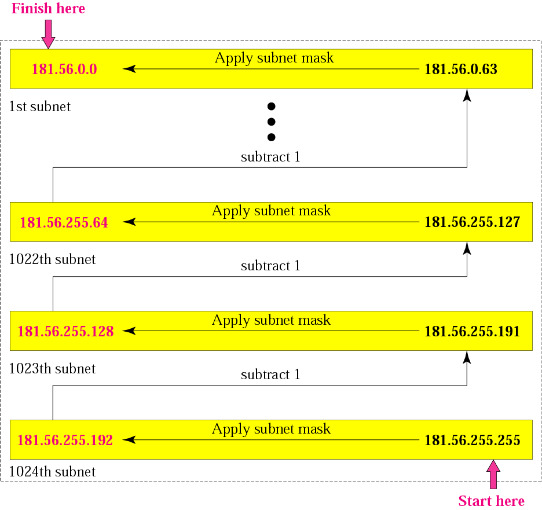
Example

Slide 63
Example: a router outside the organization receives a packet with destination address 190.240.7.91. show how it finds the network address to route the packet.
Solution
The router looks at the first byte of the address to find the class. It is class B.
The default mask for class B is 255.255.0.0. the outer ANDs this mask with the address to get 190.240.0.0
The router looks in its routing table to find out how to route the packet to this destination.

Slide 64
Example: a router inside the organization receives a packet with destination address 190.240.33.91. show how it finds the subnetwork address to route the packet.
Solution
The router must know the mask. Let it is /19.
The router applies the mask to the address 190.240.33.91. the subnetwork address is 190.240.32.0
The router looks in its routing table to find out how to route the packet to this destination.

Slide 65
Subnetting Based on Host Requirements
There are two considerations when planning subnets:
Number of Subnets required
Number of Host addresses required
Formula to determine number of useable hosts
2^n-2
2^n (where n is the number the number of host bits remaining) is used to calculate the number of hosts
-2 Subnetwork ID and broadcast address cannot be used on each subnet
Notes:
9.1.4 Determining the Subnet Mask
9.1.4.1 Subnetting based on Host Requirements

Slide 66
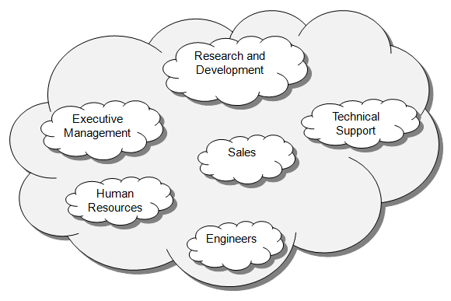
Subnetting Network-Based Requirements
Calculate number of subnets
Formula 2^n (where n is the number of bits borrowed)
Subnet needed for each department in graphic
Notes:
9.1.4.2 Subnetting Network-Based Requirements

Slide 67
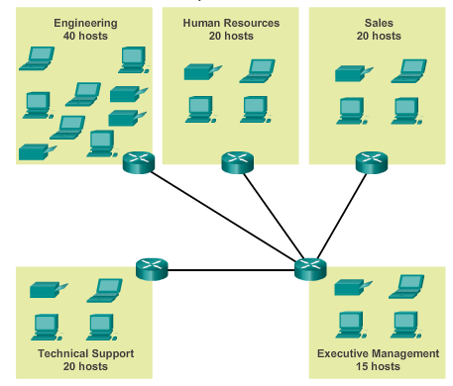
Subnetting To Meet Network Requirements
It is important to balance the number of subnets needed and the number of hosts required for the largest subnet.
Design the addressing scheme to accommodate the maximum number of hosts for each subnet.
Allow for growth in
each subnet.
Notes:
9.1.4.3 Subnetting to Meet Network Requirements

Slide 68
Variable Length Subnet Mask
Subnetting creates subnets with equal number of hosts, in a network.
The number of bits subnetted i.e. the length of subnet mask will be same for all the subnets.
To co-op with the variable number of hosts in subnets, in a network, number subnetted bits i.e. the length of subnet mask for the subnets will also vary.
The method of achieving subnetting, with variable length of subnet mask, is known as Variable Length Subnet Mask.
VLSM is a technique that allows network administrators to divide an IP address space into subnets of different sizes, unlike simple same-size Subnetting.

Slide 69

Slash notation

Slide 70
Slash notation is also called CIDR (classless inter domain routing) notation.

Slide 71
Example
A small organization is given a block with the beginning address and the prefix length 205.16.37.24/29 (in slash notation). What is the range of the block?

Slide 72
Solution
The beginning address is 205.16.37.24. To find the last address we keep the first 29 bits and change the last 3 bits to 1s.
Beginning: 11001111 00010000 00100101 00011000
Ending : 11001111 00010000 00100101 00011111
There are only 8 addresses in this block.

Slide 73
Example cont’d
We can find the range of addresses in Example 17 by another method. We can argue that the length of the suffix is 32 - 29 or 3. So there are 2³ = 8 addresses in this block. If the first address is 205.16.37.24, the last address is 205.16.37.31 (24 + 7 = 31).

Slide 74
A block in classes A, B, and C can easily be represented in slash notation as A.B.C.D/ n where n is either 8 (class A), 16 (class B), or 24 (class C).

Slide 75
Example
What is the network address if one of the addresses is 167.199.170.82/27?
Solution
The prefix length is 27, which means that we must keep the first 27 bits as is and change the remaining bits (5) to 0s. The 5 bits affect only the last byte. The last byte is 01010010. Changing the last 5 bits to 0s, we get 01000000 or 64. The network address is 167.199.170.64/27.

Slide 76
Example
An organization is granted the block 130.34.12.64/26. The organization needs to have four subnets. What are the subnet addresses and the range of addresses for each subnet?
Solution
The suffix length is 6. This means the total number of addresses in the block is 64 (2⁶). If we create four subnets, each subnet will have 16 addresses.

Slide 77
Solution (Continued)
Let us first find the subnet prefix (subnet mask). We need four subnets, which means we need to add two more 1s to the site prefix. The subnet prefix is then /28.
Subnet 1: 130.34.12.64/28 to 130.34.12.79/28.
Subnet 2 : 130.34.12.80/28 to 130.34.12.95/28.
Subnet 3: 130.34.12.96/28 to 130.34.12.111/28.
Subnet 4: 130.34.12.112/28 to 130.34.12.127/28.

Slide 78
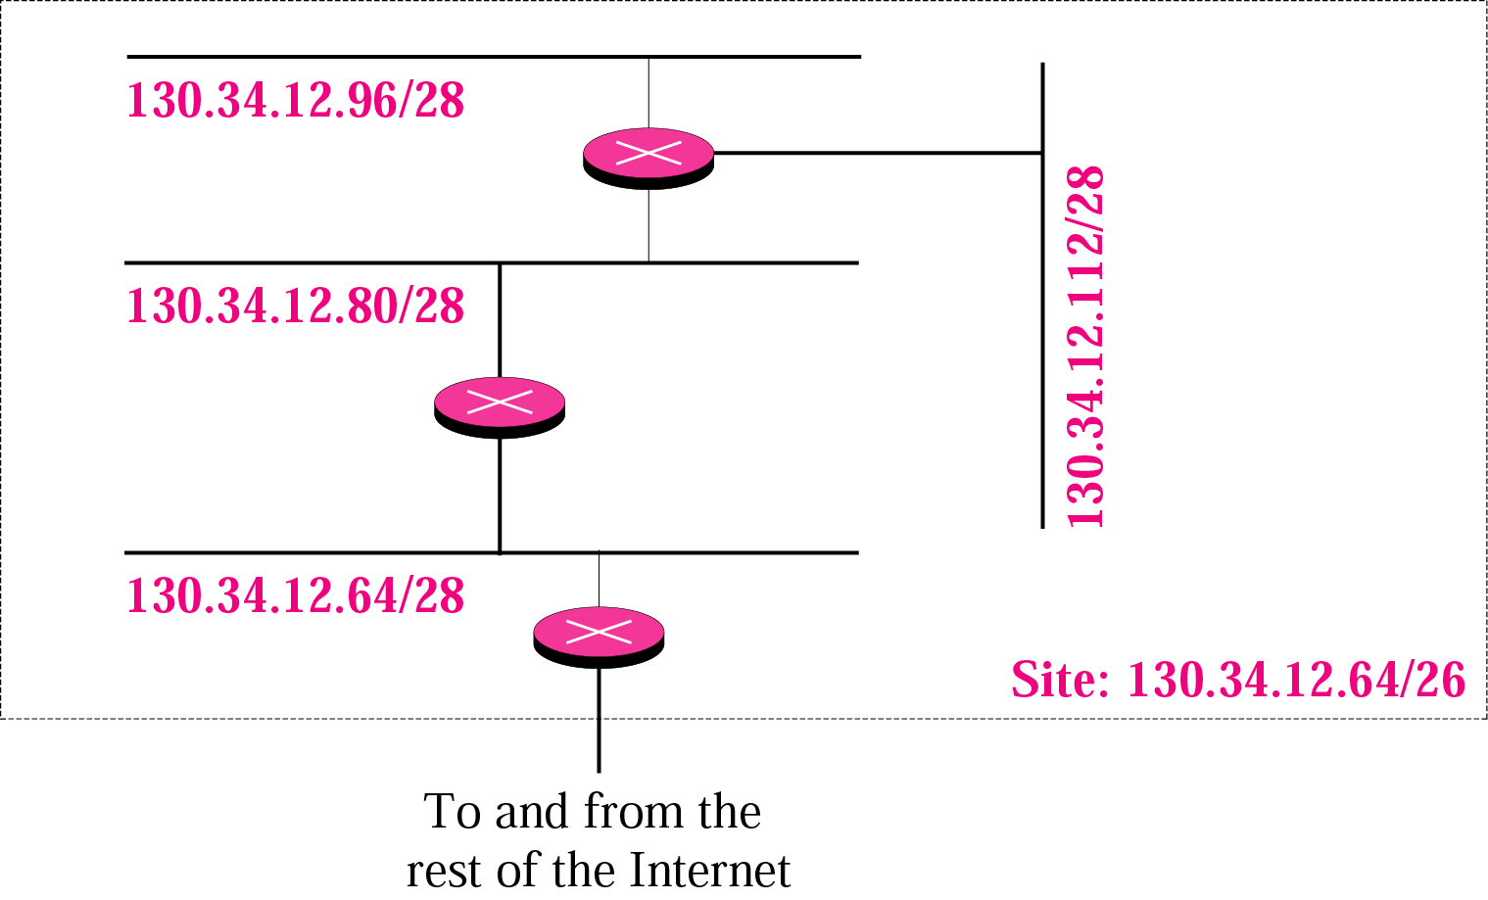
Example cont’d

Slide 79
IPV6
Deficiencies of IPV4
IPV4 has a two level address structure (netid and hostid) categorized into five classes (A, B, C, D and E). The use of address space is insufficient.
The internet must accommodate real time audio and video transmission. This type of transmission requires minimum delay strategies and reservation of resources not provided in the IPV4 design.
The internet must accommodate encryption and authentication of data for some applications. Originally, no security mechanism was provided by IPV4

Slide 80
IPV6
Advantages of IPV6 over IPV4
larger address space: an IPV6 is 128 bits long.
Better header format
New options: to allow for additional functionalities
Allowance fro extension: IPV6 is designed to allow the extension of the protocol if required by new applications.
Support for resource allocation: type of service is removed. Flow label is added. It can be used to support traffic such as real time audio and video.
Support for more security: encryption and authentication options in IPV6 provide confidentiality and integrity of the packets.

Slide 81
Advantages of IPv6
Larger Address Space
128 bits address
Better Header Format
Options separated from base header and made part of data.
Improves Routing
New Options
To allow additional functionalities
Support For More Security

Slide 82
Continued….
Allowance for extension
IPv6 is designed to handle future extensions
Support For Resource Allocation
The field “flow label” provides support for Resource allocation for special applications like real time audio and video.
Support for more Security
Encryption and authentication provides Confidentiality and Integrity.

Slide 83
Packet Format
Each Packet is composed of:
Mandatory Base Header (40 bytes)
Payload (65535 bytes)
Consists of optional extension header + data

Slide 84
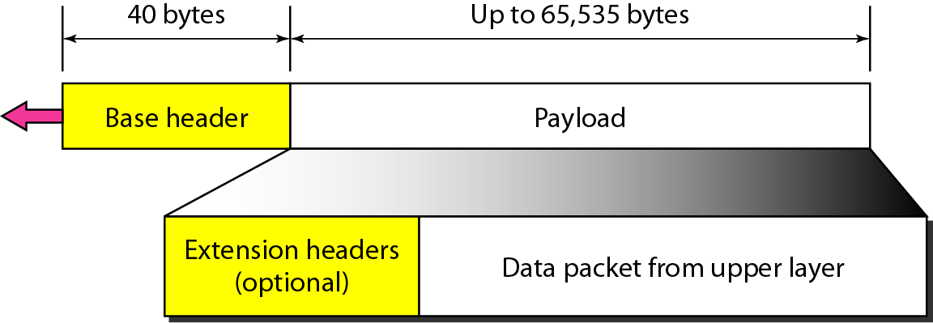
Figure IPv6 datagram header and payload

Slide 85
Base Header
There are 8 fields:
Version
4-bit in length defines the version of IP, here value is ‘6’.
Priority
4-bit defines the priority of the packet with respect to traffic congestion.
Flow Label
24-bit designed to provide special handling for a particular flow of data.

Slide 86
Payload Length
2 byte defines the length of the payload.
Next Header
8-bit
Either optional extension header or header of another protocol e.g. TCP, UDP
Just like the protocol field in IPv4.
Hop Limit
8-bit Same as TTL field in IPv4
Source Address/ Destination Address
16 bytes both

Slide 87
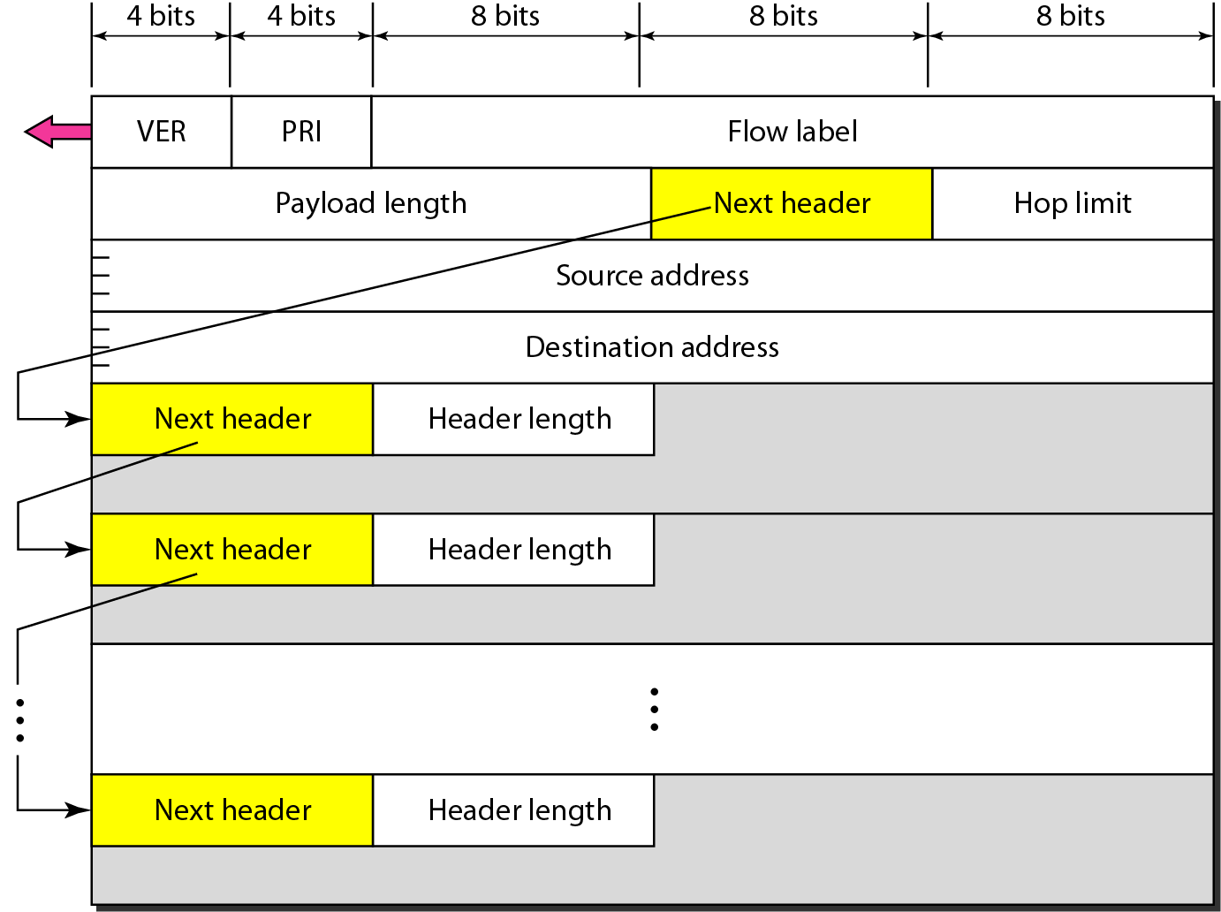
Figure Format of an IPv6 datagram

Slide 88
Table Next header codes for IPv6

Slide 89
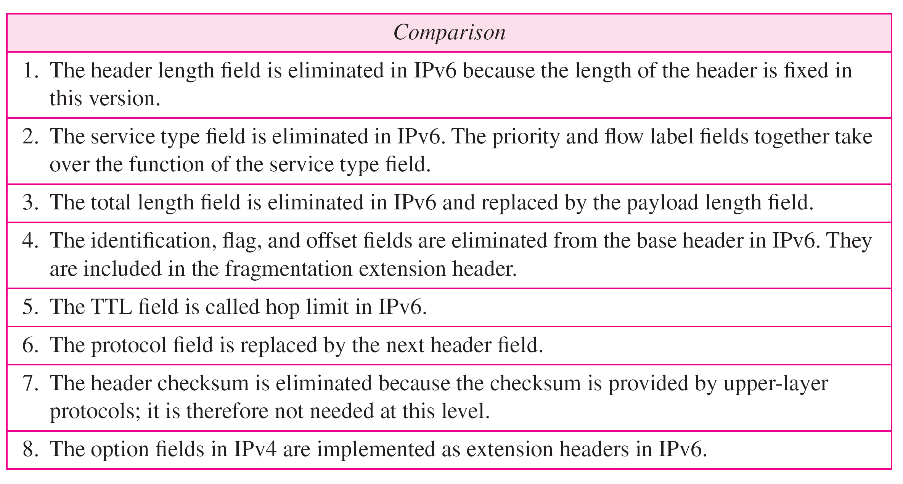
Table Comparison between IPv4 and IPv6 packet headers

Slide 90
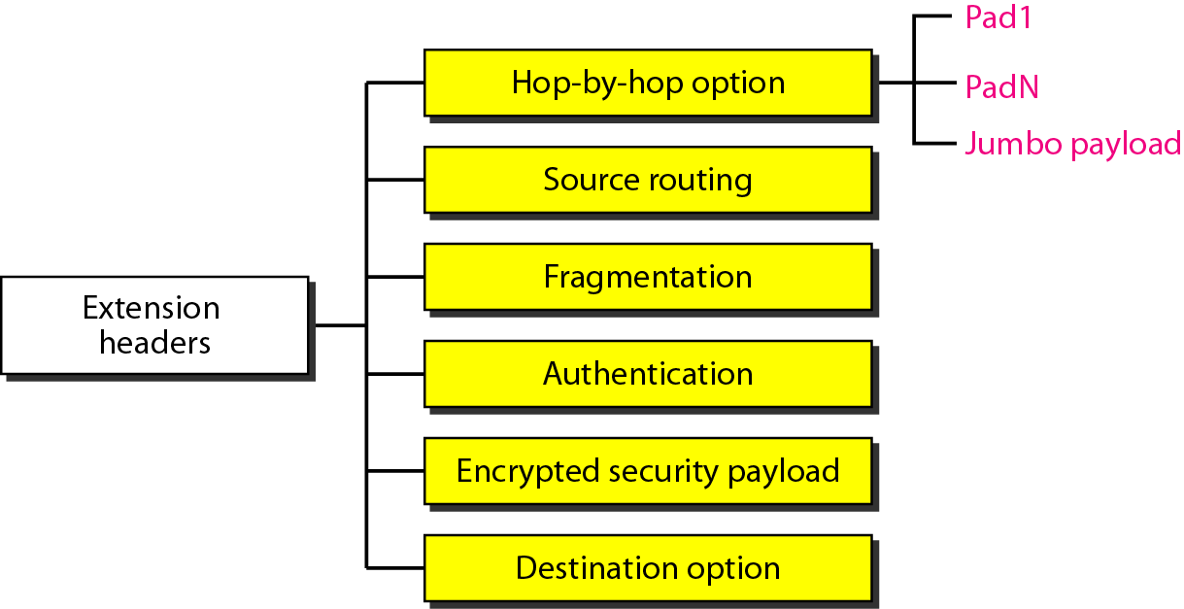
Figure Extension header types

Slide 91
Table Comparison between IPv4 options and IPv6 extension headers

Slide 92
TRANSITION FROM IPv4 TO IPv6
Because of the huge number of systems on the Internet, the transition from IPv4 to IPv6 cannot happen suddenly.
It takes a considerable amount of time before every system in the Internet can move from IPv4 to IPv6.
The transition must be smooth to prevent any problems between IPv4 and IPv6 systems.

Slide 93
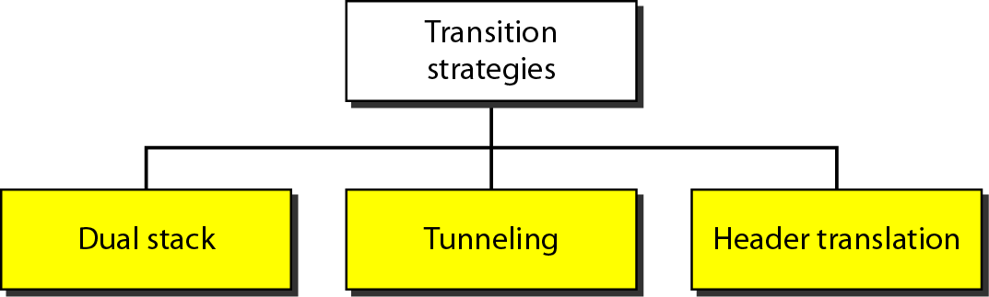
Figure Three transition strategies

Slide 94
Dual Stack
All hosts before complete migration from IPv6 to IPv4 must have a dual stack of protocols.
A station must run IPv4 and IPv6 simultaneously.
To determine which version a destination host is using, the source host queries the DNS.
If the DNS returns an IPv4 address, the source then send IPv4 packets.
If the DNS returns an IPv6 address, the source then send IPv6 packets.

Slide 95
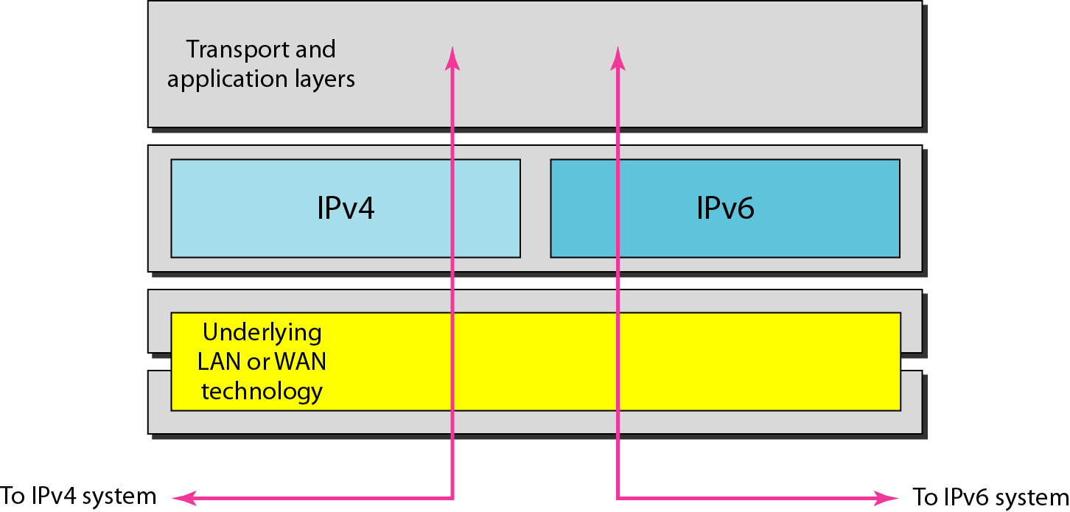
Figure Dual stack

Slide 96
Tunneling
It is a mechanism used when both sender and receiver hosts use IPv6 but in between a region falls that uses IPv4.
To pass through this region the IPv6 packet is first encapsulated in IPv4 Header and after coming out this header is removed.
The field ‘protocol’ in IPv4 has value 41 when the data it contains is an IPv6 Packet.

Slide 97
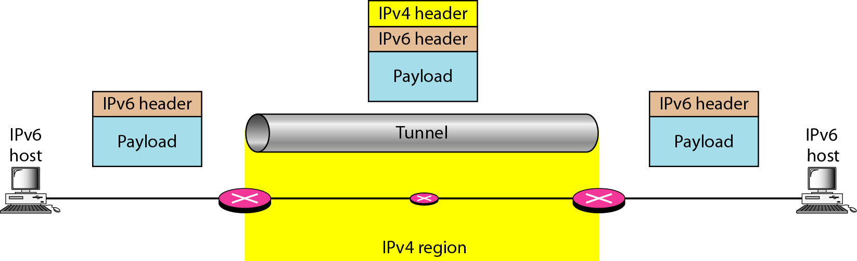
Figure Tunneling strategy

Slide 98
Header Translation
In this case the header of IPv6 is completely changed in IPv4 header.

Slide 99
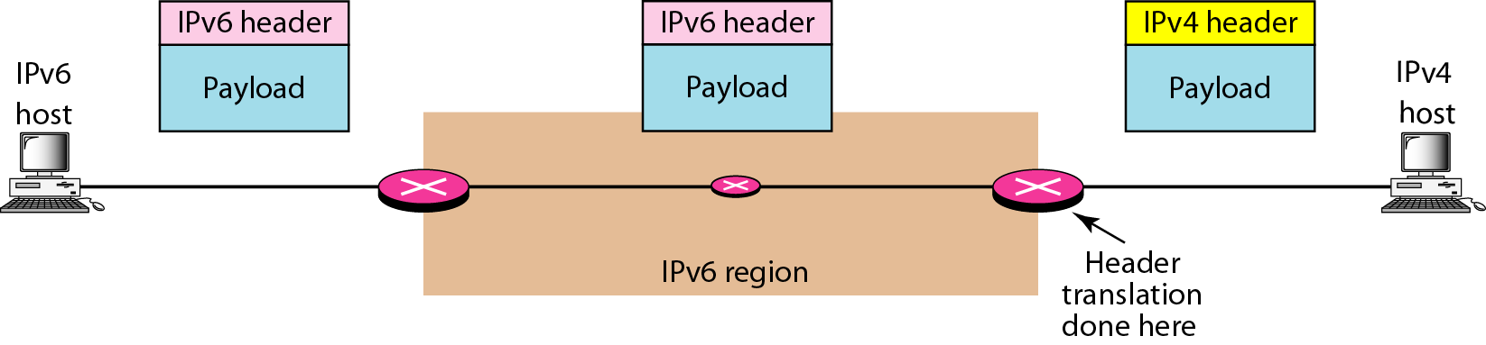
Figure Header translation strategy

Slide 100
Table Header translation

